Slide 1

Heaven’s light is our guide”
Rajshahi University of Engineering & Technology
Department of Computer Science & Engineering
Discrete Mathematics
Course No. : CSE 2101
Chapter 8: Graphs
Prepared By : Julia Rahman

Slide 2
8.1 Graphs and Graphs Models
Julia Rahman, Dept. CSE, RUET
02

Slide 3
8.1 Graphs and Graphs Models
DEFINITION 1(Graph):
A graph G=(V,E)
consists of:
V , a nonempty set of vertices, points or nodes of G
E , a set of edges of G
Each edge has either one or two vertices associated with it, called endpoints.
An edge is said to connect its endpoints.
Example:
v₁
v₅
G=(V, E), where
V={v₁,v₂,…, v₇}
E={{v₁,v₂}, {v₁,v₃}, {v₂,v₃}
{v₃,v₄}, {v₄,v₅}, {v₄,v₆}
{v₄,v₇}, {v₅,v₆}, {v₆,v₇}}
v₃
v₄
v₆
v₂
v₇
Julia Rahman, Dept. CSE, RUET
03

Slide 4
8.1 Graphs and Graphs Models
The set of vertices V of a graph G may be infinite. A graph with an infinite vertex set is called an infinite graph.
A graph with a finite vertex set is called a finite graph.
Simple graph:
Graph in which each edge connects two different vertices and
No two edges connect the same pair of vertices.
Multi graph:
May have multiple edges connecting the same vertices.
Pseudo graph:
Like a multi graph, but edges connecting a node to itself are allowed.
Trivial graph:
The finite graph with one vertex and no edges that is a single point is called trivial graph. Example:
Undirected graphs:
Edges are not directed.
Figure 2: Simple and undirected graph
v₅
v₄
v₆
v₇
Julia Rahman, Dept. CSE, RUET
04

Slide 5
8.1 Graphs and Graphs Models
v₁
v₅
i
h
v₃
v₄
v₆
a
g
v₇
j
v₂
Figure 3: Multi graph
Figure 4: Pseudo graph
Directed graph:
A directed graph (V,E) consists of a set of vertices V and a set of directed edged E.
Each directed edges is associated with an ordered pair of vertices.
The directed edge associated with the ordered pair.
is allowed in a directed graph
Mixed graph:
Graph with both directed and undirected edge.
Julia Rahman, Dept. CSE, RUET
05

Slide 6
8.1 Graphs and Graphs Models
Graph Terminology:
Graph models:
Influence graph
Hollywood graph
Round robin tournaments
Call graph
The web graph
Roadmaps
Type | Edges | Multiple Edges | Loops
(simple) graph | Undirected edge: {u,v} |  | 
Multigraph |  |  | 
Pseudograph |  |  | 
Directed graph | directed edge: (u,v) |  | 
Directed multi graph |  |  | 
Julia Rahman, Dept. CSE, RUET
06

Slide 7
8.2 Graph Terminology and
Special Types of Graphs
Julia Rahman, Dept. CSE, RUET
07

Slide 8
8.2 Graph Terminology and Special Types of Graphs
Definition – 1(adjacent):
G = (v,e) : undirected graph
if u --e-- v ==>
u and v are adjacent (or neighbors)
Edge e is incident with u (& v).
e connects u and v.
u and v are end points of e.
Definition – 2(degree):
Let G be an undirected graph, v ∈ V a vertex.
The degree of v, deg(v), is its number of incident edges. (Except that any self-loops are counted twice.)
A vertex with degree 0 is isolated.
A vertex of degree 1 is pendant.
In the figure deg(a) = 2, deg(b) = deg(c) = deg(f) = 4, deg(e) = 3, deg(d) = 1 and deg(g) = 0.
u
e
v
b
c
d
a
e
g
f
Julia Rahman, Dept. CSE, RUET
08

Slide 9

8.2 Graph Terminology and Special Types of Graphs
a
b
c
In the figure deg(a)=4, deg(b)=6, deg(c)=1, deg(d)=5, deg(e)=6
Theorem 1:
Let G be an undirected (simple, multi-, or pseudo-) graph with vertex set V and edge set E. Then
2e =
Note that this applies even if multiple edges and loops are present.
Example 3. How many edges are there in a graph with 10 vertices each of degree six?
Solution: Because the sum of the degrees of the vertices is 6 · 1 0 = 60, it follows that 2e = 60. Therefore, e = 30.
e
d
$$\sum_{∈ V}{deg⁡()}$$
Julia Rahman, Dept. CSE, RUET
09

Slide 10
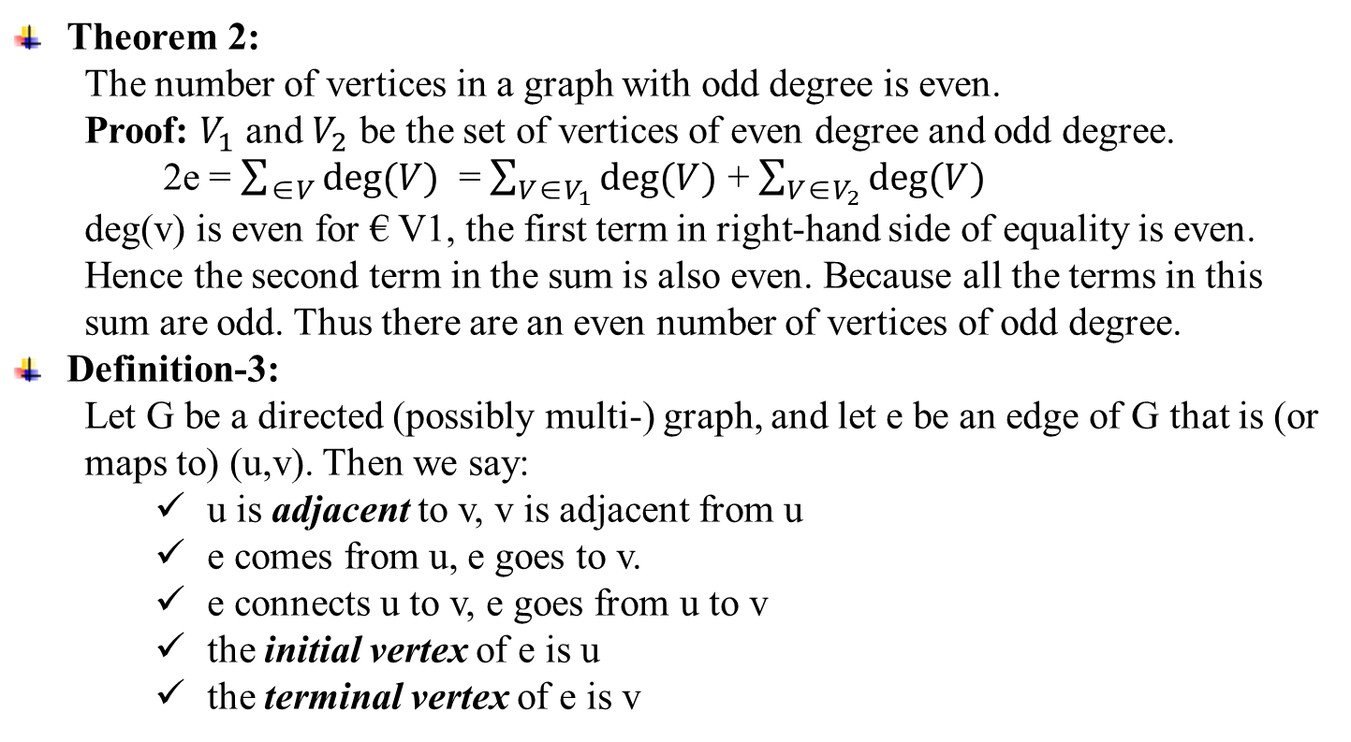
8.2 Graph Terminology and Special Types of Graphs
Theorem 2:
The number of vertices in a graph with odd degree is even.
Proof: $V_{1}$ and $V_{2}$ be the set of vertices of even degree and odd degree.
2e = $\sum_{\text{∈}V}{deg⁡(V)}$ = $\sum_{V\text{∈}V_{1}}{deg⁡(V)}$ + $\sum_{V\text{∈}V_{2}}{deg⁡(V)}$
deg(v) is even for € V1, the first term in right-hand side of equality is even. Hence the second term in the sum is also even. Because all the terms in this sum are odd. Thus there are an even number of vertices of odd degree.
Definition-3:
Let G be a directed (possibly multi-) graph, and let e be an edge of G that is (or maps to) (u,v). Then we say:
u is adjacent to v, v is adjacent from u
e comes from u, e goes to v.
e connects u to v, e goes from u to v
the initial vertex of e is u
the terminal vertex of e is v
Julia Rahman, Dept. CSE, RUET
10

Slide 11
8.2 Graph Terminology and Special Types of Graphs
Definition-4:
Let G be a directed graph, v a vertex of G.
The in-degree of v, deg⁻(v), is the number of edges going to v or the number of edges with as their terminal vertex.
The out-degree of v, deg⁺(v) , is the number of edges coming from v or the number of edges with as their initial vertex.
The degree of v, deg(v) = deg⁻(v) + deg⁺(v) , is the sum of v’s in-degree and out-degree.
Example 4: Find the in-degree and out-degree of each vertex in the graph G with directed edges.
b
a
deg⁻(a)=2, deg⁺(a)=4
deg⁻(b)=2, deg⁺(b)=1
deg⁻(c)=3, deg⁺(c)=2
deg⁻(d)=2, deg⁺(d)=2
deg⁻(e)=3, deg⁺(e)=3
deg⁻(f )=0, deg⁺(f )=0
c
e
d
f
Julia Rahman, Dept. CSE, RUET
11

Slide 12
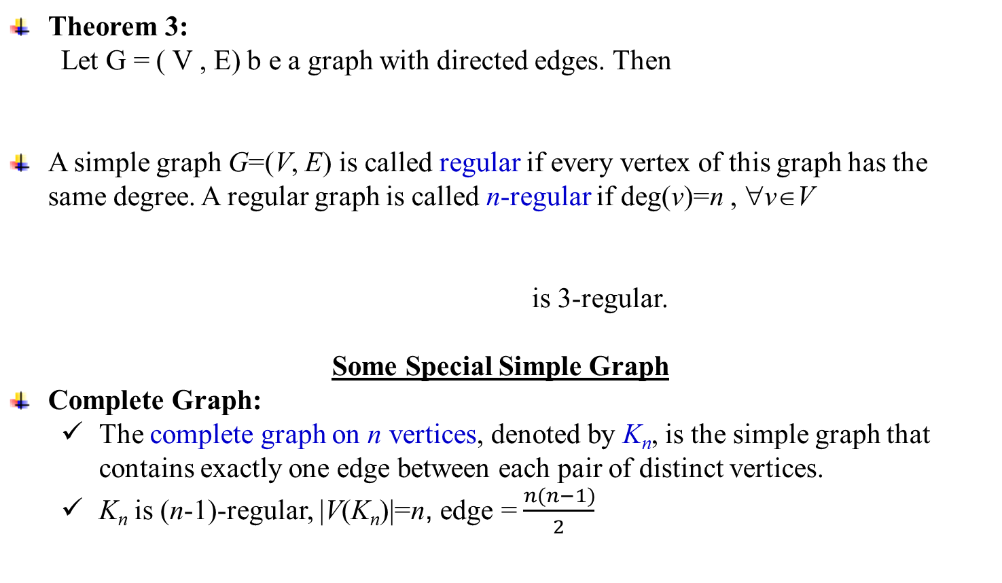
8.2 Graph Terminology and Special Types of Graphs
Theorem 3:
Let G = ( V , E) b e a graph with directed edges. Then
A simple graph G=(V, E) is called regular if every vertex of this graph has the same degree. A regular graph is called n-regular if deg(v)=n , ∀v∈V
is 3-regular.
Some Special Simple Graph
Complete Graph:
The complete graph on n vertices, denoted by K_{n}, is the simple graph that contains exactly one edge between each pair of distinct vertices.
K_{n} is (n-1)-regular, |V(K_{n})|=n, edge = $\frac{n(n−1)}{2}$
K₁
K₂
K₃
K₄
Julia Rahman, Dept. CSE, RUET
12

Slide 13
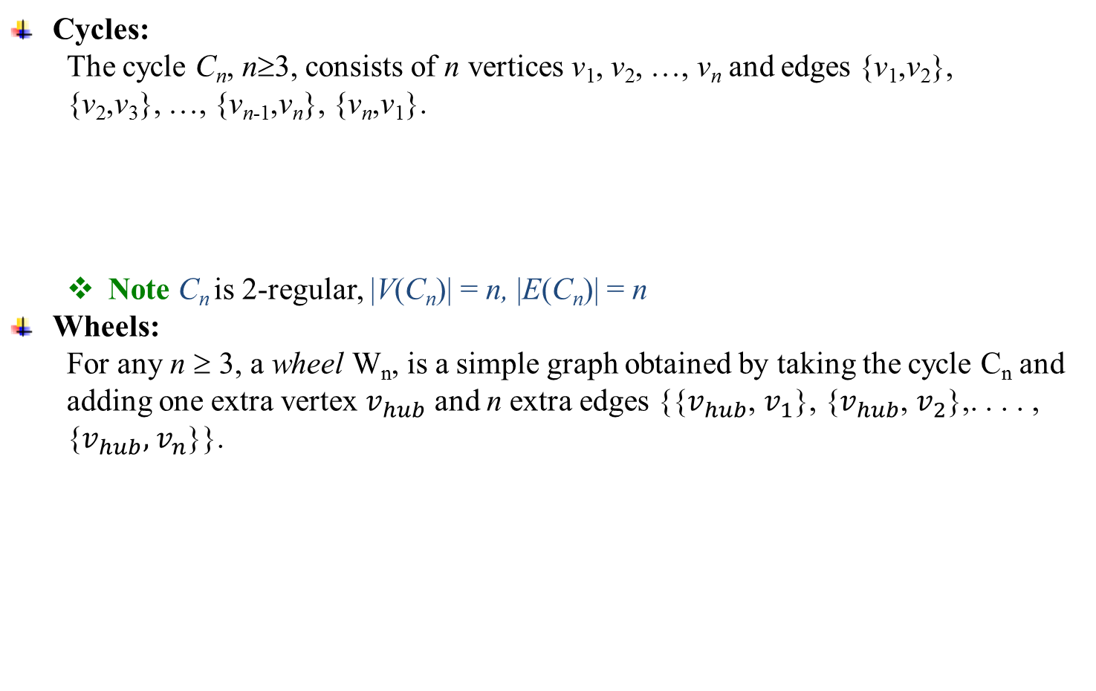
8.2 Graph Terminology and Special Types of Graphs
Cycles:
The cycle C_{n}, n≥3, consists of n vertices v₁, v₂, …, v_{n} and edges {v₁,v₂}, {v₂,v₃}, …, {v_{n-1},v_{n}}, {v_{n},v₁}.
Note C_{n} is 2-regular, |V(C_{n})| = n, |E(C_{n})| = n
Wheels:
For any n ≥ 3, a wheel W_{n}, is a simple graph obtained by taking the cycle C_{n} and adding one extra vertex $v_{hub}$ and n extra edges {{$v_{hub}$, $v_{1}$}, {$v_{hub}$, $v_{2}$},. . . . , {$v_{hub},$ $v_{n}$}}.
C₆
C₃
C₄
C₅
W₃
W₄
W₅
W₆
Julia Rahman, Dept. CSE, RUET
13

Slide 14
8.2 Graph Terminology and Special Types of Graphs
Bipartite Graphs:
A simple graph G=(V,E) is called bipartite if V can be partitioned into V₁ and V₂, V₁∩V₂=∅, such that every edge in the graph connect a vertex in V₁ and a vertex in V₂.
EXAMPLE 9:
C₆ is bipartite. Because
Example: Is C₃ bipartite?
No, because there is no way to partition the vertices into two sets so that there are no edges with both endpoints in the same set.
v₁
v₂
C₆
v₃
v₄
v₅
v₆
V₁
V₂
C₃
Julia Rahman, Dept. CSE, RUET
14

Slide 15
8.2 Graph Terminology and Special Types of Graphs
EXAMPLE 11: Is the graph G bipartite?
a
b
a
c
g
c
e
b
f
f
d
d
g
e
G
Julia Rahman, Dept. CSE, RUET
15

Slide 16
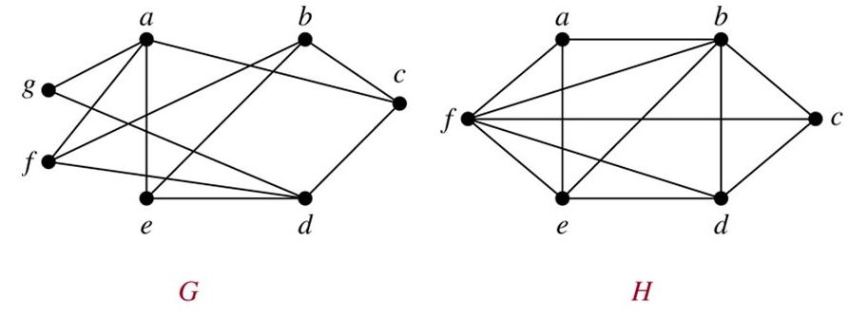
8.2 Graph Terminology and Special Types of Graphs
EXAMPLE 11: Are the graph G and H bipartite?
Julia Rahman, Dept. CSE, RUET

Slide 17
8.2 Graph Terminology and Special Types of Graphs
THEOREM 4:
A simple graph is bipartite if and only if it is possible to assign one of two different colors to each vertex of the graph so that no two adjacent vertices are assigned the same color.
Complete bipartite graph:
The complete bipartite graph K_{m,n} is the graph that has its vertex set partitioned into two subsets of m and n vertices, respectively.
Two vertices are connected if and only if they are in different subsets.
K_{3,2}
K_{3,4}
Julia Rahman, Dept. CSE, RUET
16

Slide 18
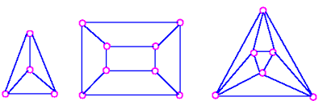
8.2 Graph Terminology and Special Types of Graphs
EXAMPLE 11: Are the graphs complete bipartite?
Julia Rahman, Dept. CSE, RUET

Slide 19
8.2 Graph Terminology and Special Types of Graphs
Definition 6:
A subgraph of a graph G=(V, E) is a graph H=(W, F) where W ⊆ V and F ⊆ E.
Example 14: A subgraph of K₅
a
a
e
b
e
b
d
c
subgraph of K₅
c
K₅
Julia Rahman, Dept. CSE, RUET
17

Slide 20
8.2 Graph Terminology and Special Types of Graphs
Definition 7:
The union of two simple graphs G₁=(V₁, E₁) and G₂=(V₂, E₂) is the simple graph
G₁∪G₂=(V₁∪V₂, E₁∪E₂)
Example 15:
a
b
c
a
b
c
G₁
G₂
d
e
d
f
a
b
c
G₁∪G₂
d
e
f
Julia Rahman, Dept. CSE, RUET
18

Slide 21
8.3 Representing Graphs and Graph Isomorphism
Julia Rahman, Dept. CSE, RUET
19

Slide 22
8.3 Representing Graphs and Graph Isomorphism
Adjacency list:
A table with 1 row per vertex, listing its adjacent vertices.
Which specify the vertices that are adjacent to each vertex of the graph.
In directed graph listing the terminal nodes of each edge incident from that node.
Example 1: Use adjacency lists to describe the simple graph given below.
b
Vertex | Adjacent Vertices
a | b,c,e
b | a
c | a,d,e
d | c,e
e | a,c,d
a
c
e
d
Julia Rahman, Dept. CSE, RUET
20

Slide 23
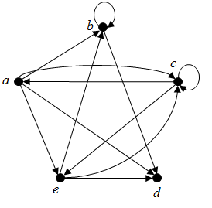
8.3 Representing Graphs and Graph Isomorphism
Example 2: Represent the directed graph by listing all the vertices that are the terminal vertices of edges starting at each vertex of the graph.
Adjacency Matrices:
G=(V, E) : simple graph, V={v₁,v₂,…,v_{n}}.
A matrix A is called the adjacency matrix of G
if A=[a_{ij}]_{n×n} , where a_{ij} = 1, if {v_{i},v_{j}}∈E, 0, otherwise.
Initial vertex | Terminal vertices
a | b,c,d,e
b | b,d
c | a,c,e
d
e | b,c,d
Julia Rahman, Dept. CSE, RUET
21

Slide 24
8.3 Representing Graphs and Graph Isomorphism
Example 3: Use an adjacency matrix to represent the graph shown in Figure.
Example 5: Use an adjacency matrix to represent the pseudograph.
a
b
c
d
b
d
c
a
a
b
a
b
b
d
c
c
c
d
a
d
Note:
There are n! different adjacency matrices for a graph with n vertices.
The adjacency matrix of an undirected graph is symmetric.
b
a
b
c
d
a
a
b
c
d
c
d
Julia Rahman, Dept. CSE, RUET
22

Slide 25
8.3 Representing Graphs and Graph Isomorphism
Example 6:
If A=[a_{ij}] is the adjacency matrix for the directed graph, then
Incidence Matrices:
Let G = (V, E) be an undirected graph. The vertices and edges of G are listed in arbitrary order as v₁, v₂, …, v_{n} and e₁, e₂, …, e_{m}, respectively.
The incidence matrix of G with respect to this listing of the vertices and edges is the n×m zero-one matrix with 1 as its (i, j) entry when edge e_{j} is incident with v_{i}, and 0 otherwise.
Example 6: Using an incidence matrix, represent the following undirected graph:
1 , if
a_{ij} =
v_{i}
v_{j}
0 , otherwise
1 , if edge e_{j} is incident with v_{i}
m_{ij} =
0 , otherwise
v₁
v₂
e₁ e₂ e₃ e₄ e₅ e₆
e₆
v₃
v₁
v₂
v₃
v₄
v₅
e₂
e₄
e₅
e₁
e₃
v₄
v₅
Julia Rahman, Dept. CSE, RUET
23

Slide 26
8.3 Representing Graphs and Graph Isomorphism
Isomorphism of Graph
Definition 1:
The simple graphs G₁ = (V₁,E₁) and G₂ = (V₂,E₂) are isomorphic if there is a one-to-one and onto function f from V₁ to V₂ with the property that a and b are adjacent in G₁ if and only if f(a) and f(b) are adjacent in G₂, for all a and b in V₁. Such a function f is called an isomorphism.
Necessary condition for G₁ = (V₁,E₁) to be isomorphic to G₂ = (V₂,E₂):
V₁ = V₂, and E₁ = E₂
The number of vertices with degree n is the same in both graphs.
For every proper subgraph g of one graph, there is a proper subgraph of the other graph that is isomorphic to g.
Example 8: Show that the graphs G = (V,E) and H = (W,F) are isomorphic.
Solution: The function f with f(u₁) = v₁, f(u₂) = v₄, f(u₃) = v₃, f(u₄) = v₂ is a one-to-one correspondence between V and W. f(u₁) = v₁ and f(u₂) = v₄, f(u₁) = v₁ and f(u₃) = v₃, f(u₂) = v₄ and f(u₃) = v₃, and f(u₁) = v₁ and f(u₄) = v₂ are adjacent in H.
u₁
u₂
v₁
v₂
u₃
u₄
v₃
H
v₄
G
Julia Rahman, Dept. CSE, RUET
24

Slide 27
8.3 Representing Graphs and Graph Isomorphism
Example 9: Show that G and H are not isomorphic.
Solution: Both G and H have five vertices and six edges. However, H has a vertex of degree one, namely, e , whereas G has no vertices of degree one. It follows that G and H are not isomorphic.
Example 10: Determine whether G and H are isomorphic.
Solution: G and H are not isomorphic. Because deg(a) = 2 in G, a must correspond to either t, u , x , or y in H, because these are the vertices of degree
G
H
a
b
s
t
w
x
e
f
g
z
y
h
d
c
v
u
Julia Rahman, Dept. CSE, RUET
25

Slide 28
8.3 Representing Graphs and Graph Isomorphism
two in H . However, each of these four vertices in H is adjacent to another vertex of degree two in H, which is not true for a in G.
Another way to see that G and H are not isomorphic is to note that the subgraphs of G and H made up of vertices of degree three and the edges connecting them must be isomorphic if these two graphs are isomorphic.
Example 11: Determine whether the graphs G and H are isomorphic.
Solution: f(u₁)=v₆, f(u₂)=v₃, f(u₃)=v₄, f(u₄)=v₅, f(u₅)=v₁, f(u₆)=v₂ ⇒Yes
G
v₁
H
v₃
u₁
u₂
v₂
u₅
u₆
v₆
u₄
u₃
v₅
v₄
Julia Rahman, Dept. CSE, RUET
26

Slide 29
8.3 Representing Graphs and Graph Isomorphism
Example: Determine whether the graphs G and H are isomorphic.
G
H
u₁
v₁
u₂
v₂
u₈
v₈
u₃
v₃
u₇
v₇
u₆
v₆
v₄
u₄
u₅
v₅
Solution: Yes
Julia Rahman, Dept. CSE, RUET
27

Slide 30
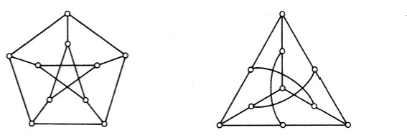
8.3 Representing Graphs and Graph Isomorphism
Example: Determine whether the graphs G and H are isomorphic.
G
H
Solution: Yes
Julia Rahman, Dept. CSE, RUET

Slide 31
8.4 Connectivity
Julia Rahman, Dept. CSE, RUET
28

Slide 32
8.4 Connectivity
Path:
A path is a sequence of edges that begins at a vertex of a graph and travels from vertex to vertex along edges of the graph.
Let n be a nonnegative integer and G an undirected graph.
A path of length n from u to v in G is a sequence of n edges e₁, e₂, …, e_{n} of G such that f(e₁) = {x₀, x₁}, f(e₂) = {x₁, x₂}, …, f(e_{n}) = {x_{n-1}, x_{n}}, where x₀ = u and x_{n} = v.
When graph is simple, path is denoted by its vertex sequence x₀, x₁, …, x_{n}.
The path is a circuit if it begins and ends at the same vertex, that is, if u = v, and has length greater than zero.
The path or circuit is said to pass through the vertices x₁, x₂, …, x_{n-1} or traverse the edges e₁, e₂, …, e_{n}.
A path or circuit is simple if it does not contain the same edge more than once.
Example:
Solution: G and H are not isomorphic. Because deg(a) = 2 in G, a must correspond to either t, u , x , or y in H, because these are the vertices of degree
v
w
path: u, v, y
cycle: u, v, y, x, u
u
x
y
Julia Rahman, Dept. CSE, RUET
29

Slide 33
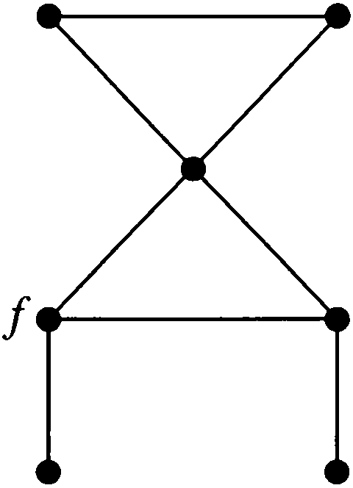



8.4 Connectivity
Connectedness:
An undirected graph is connected if and only if there is a path between every pair of distinct vertices in the graph.
Two computers in the network can communicate if and only if this network is connected.
Example 5: The graph $G_{1}$ in Figure is connected, because for every pair of distinct vertices there is a path between them (the reader should verify this). However, the graph $G_{2}$ in Figure is not connected. For instance, there is no path in $G_{2}$ between vertices a and d.
a
b
a
b
f
c
c
d
d
e
$$G_{2}$$
g
e
$$G_{1}$$
Julia Rahman, Dept. CSE, RUET
30

Slide 34
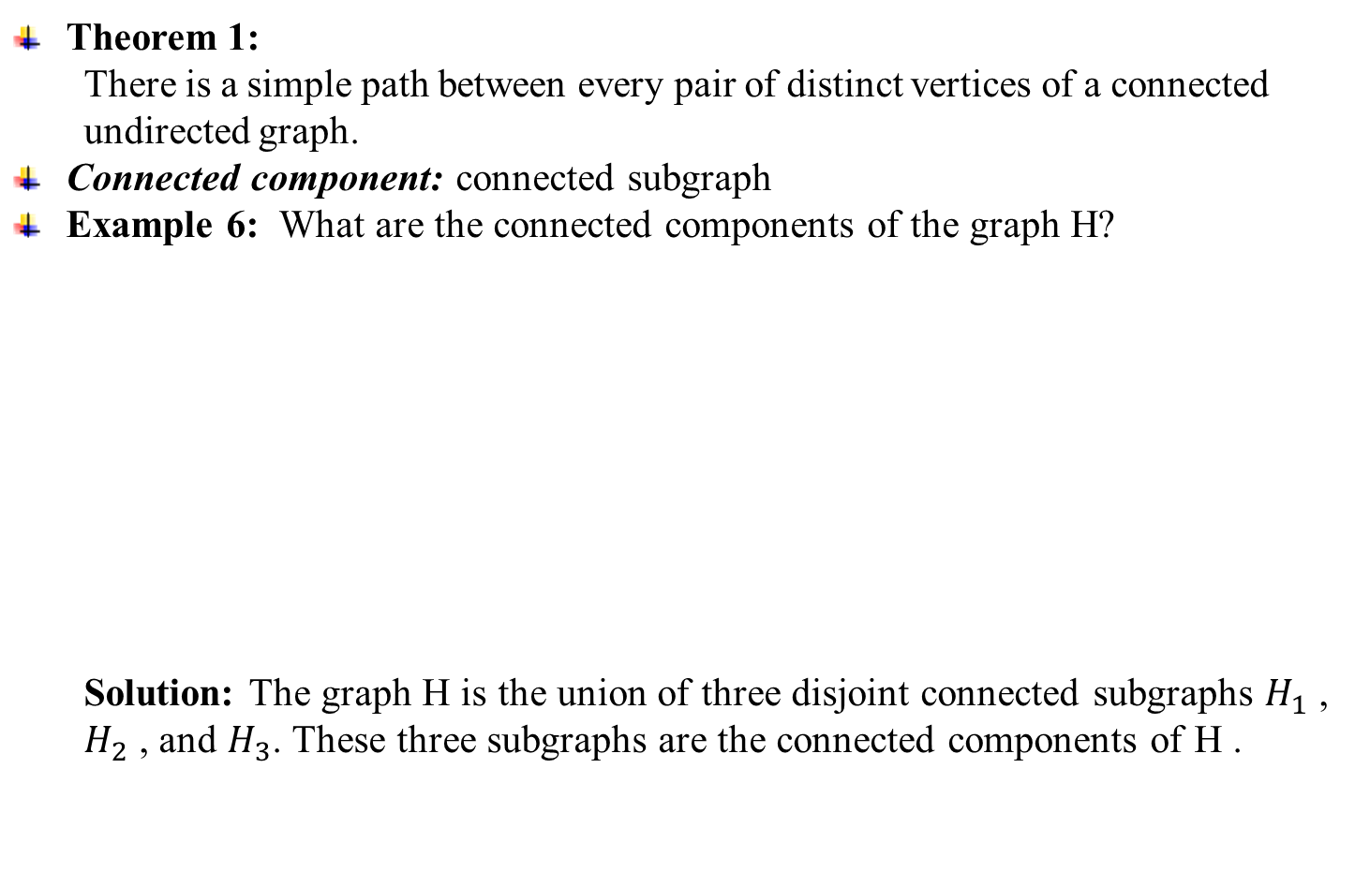



8.4 Connectivity
Theorem 1:
There is a simple path between every pair of distinct vertices of a connected undirected graph.
Connected component: connected subgraph
Example 6: What are the connected components of the graph H?
Solution: The graph H is the union of three disjoint connected subgraphs $H_{1}$ , $H_{2}$ , and $H_{3}$. These three subgraphs are the connected components of H .
$$H_{1}$$
$$H_{2}$$
f
b
$$H_{3}$$
d
e
a
h
g
c
_{H}
Julia Rahman, Dept. CSE, RUET
31

Slide 35
8.4 Connectivity
Definition:
A cut vertex separates one connected component into several components if it is removed.
A cut edge separates one connected component into two components if it is removed.
Example 8: Find the cut vertices and cut edges in the graph G.
Solution: cut vertices: b, c, e & cut edges: {a, b}, {c, e}
Definition 4:
A directed graph is strongly connected if there is a path from a to b for any two vertices a, b.
Definition 5:
A directed graph is weakly connected if there is a path between every two vertices in the underlying undirected graphs.
a
d
f
g
G
b
c
e
h
Julia Rahman, Dept. CSE, RUET
32

Slide 36
8.4 Connectivity
Example 9: Are the directed graphs G and H strongly connected or weakly connected?
Solution: G is strongly connected because there is a path between any two vertices in this directed graph. Hence, G is also weakly connected.
The graph H is not strongly connected. There is no directed path from a to b in this graph. However, H is weakly connected, because there is a path between any two vertices in the underlying undirected graph of H.
a
b
a
b
G
H
c
c
e
d
e
d
Julia Rahman, Dept. CSE, RUET
33

Slide 37
8.4 Connectivity
Paths and Isomorphism:
Note that connectedness, and the existence of a circuit or simple circuit of length k are graph invariants with respect to isomorphism.
Paths and circuits can help determine whether 2 graphs are isometric
The existence of a simple circuit (or cycle) of a particular length is a useful invariant to show that 2 graphs are not isomorphic
Example 12: Determine whether the graph G and H are isomorphic.
Solution: Both G and H have 6 vertices and 8 edges. Each has 4 vertices of degree 3, and 2 vertices of degree 2. However, H has a simple circuit of length 3, namely, v₁, v₂, v₆, v₁ whereas G has no simple circuit of length 3, as can be determined by inspection (all simple circuits in G have length at least four). G and H are not isomorphic.
u₁
v₁
u₂
u₆
v₂
v₆
u₃
u₅
v₃
v₅
G
u₄
H
v₄
Julia Rahman, Dept. CSE, RUET
34

Slide 38
8.4 Connectivity
Example 13. Determine whether the graphs G and H are isomorphic.
u₂
v₁
G
H
u₁
u₃
v₅
v₂
u₅
u₄
v₄
v₃
Solution: Both G and H have 5 vertices, 6 edges, two vertices of deg 3, three vertices of deg 2, a 3-cycle, a 4-cycle, and a 5-cycle. ⇒ G and H may be isomorphic.
The function f with f(u₁) = v₁, f(u₂) = v₄, f(u₃) = v₃, f(u₄) = v₂ and f(u₅) = v₅ is a one-to-one correspondence between V(G) and V(H). ⇒ G and H are isomorphic.
Counting Paths between Vertices
Theorem 2: Let G be a graph with adjacency matrix A with respect to the ordering v₁, v₂, …, v_{n} (with directed or undirected edges, with multiple edges and loops allowed). The number of different paths of length r from v_{i} to v_{j}, where r is a positive integer is equals to the (i, j)th entry of A^{r}.
35

Slide 39
8.4 Connectivity
Example 14: How many paths of length 4 are there from a to d in the simple graph G?
Solution: The adjacency matrix of G
there are exactly eight paths of length four from a to d. By inspection of the graph, we see that a , b, a , b, d; a , b, a , c, d; a , b, d, b, d; a , b, d, c, d; a , c, a , b, d; a , c, a , c, d; a , c, d, b, d; and a , c, d, c, d are the eight paths from a to d. (ordering as a, b, c, d) is
a
b
G
d
c
a
b
c
d
a
b
⇒
⇒ 8
c
d
Julia Rahman, Dept. CSE, RUET
36

Slide 40
8.5 Euler & Hamilton Paths
Julia Rahman, Dept. CSE, RUET
27

Slide 41
8.5 Euler & Hamilton Paths
The Seven Bridges of Konigsberg:
In Konigsberg, Germany, a river ran through the city such that in its center was an island, and after passing the island, the river broke into two parts. Seven bridges were built so that the people of the city could get from one part to another.
Is it possible to walk through the city that would cross each bridge once and only once?
c
C
D
d
a
A
b
B
Fig-2: multigraph model of the town of konigsberg
Fig-a: the seven bridges of konigsberg
Julia Rahman, Dept. CSE, RUET
38

Slide 42
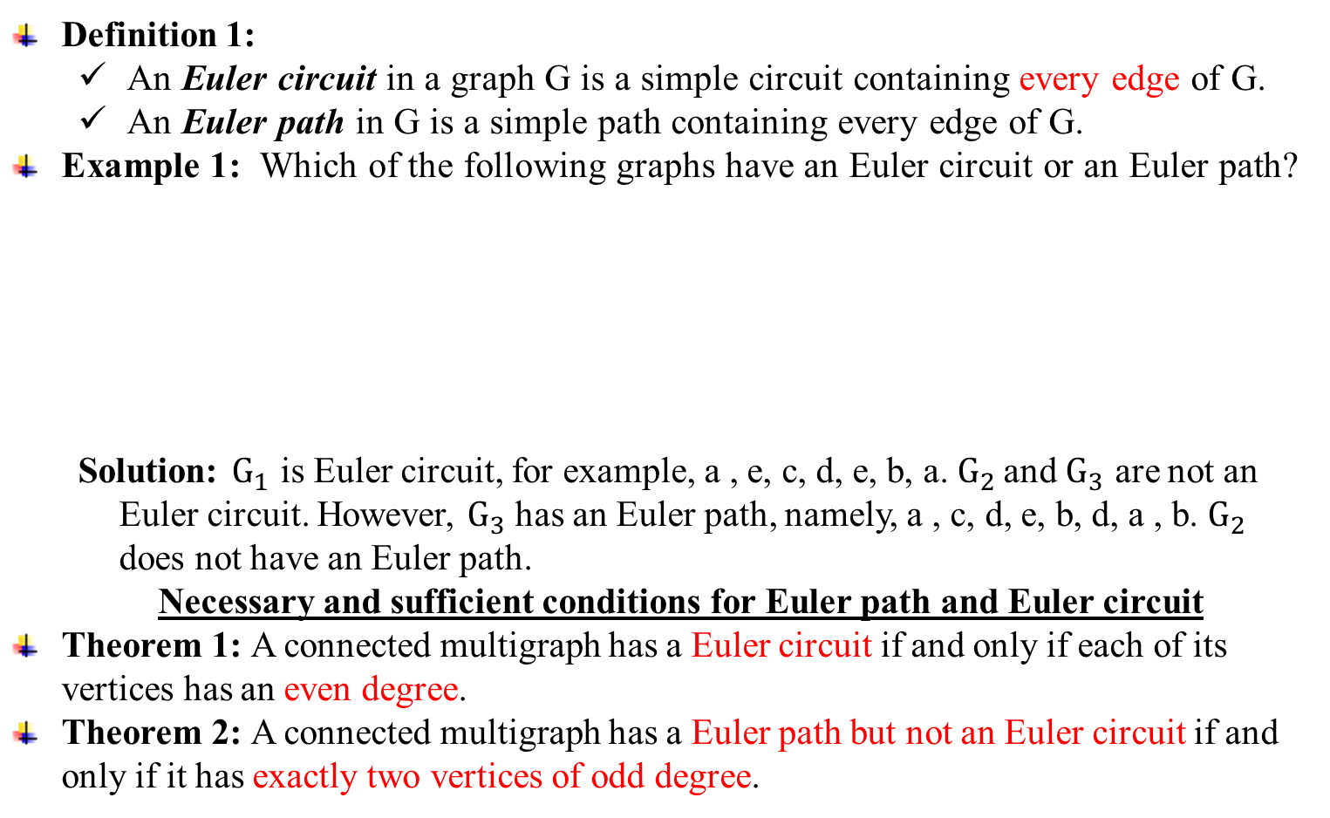
8.5 Euler & Hamilton Paths
Definition 1:
An Euler circuit in a graph G is a simple circuit containing every edge of G.
An Euler path in G is a simple path containing every edge of G.
Example 1: Which of the following graphs have an Euler circuit or an Euler path?
Solution: $G_{1}$ is Euler circuit, for example, a , e, c, d, e, b, a. $G_{2 }$and $G_{3}$ are not an Euler circuit. However, $G_{3}$has an Euler path, namely, a , c, d, e, b, d, a , b. $G_{2 }$ does not have an Euler path.
Necessary and sufficient conditions for Euler path and Euler circuit
Theorem 1: A connected multigraph has a Euler circuit if and only if each of its vertices has an even degree.
Theorem 2: A connected multigraph has a Euler path but not an Euler circuit if and only if it has exactly two vertices of odd degree.
a
a
b
G₃
a
b
b
G₁
e
G₂
e
c
d
c
c
d
e
d
Julia Rahman, Dept. CSE, RUET
39

Slide 43
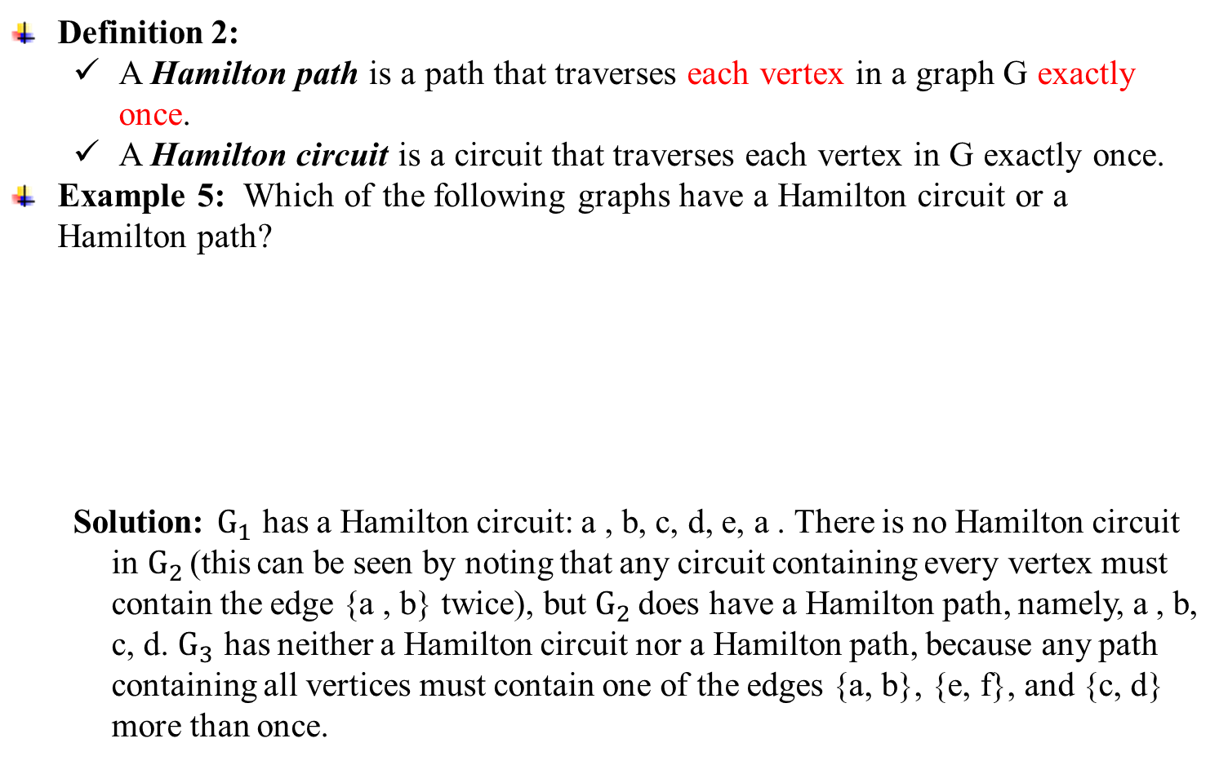
8.5 Euler & Hamilton Paths
Definition 2:
A Hamilton path is a path that traverses each vertex in a graph G exactly once.
A Hamilton circuit is a circuit that traverses each vertex in G exactly once.
Example 5: Which of the following graphs have a Hamilton circuit or a Hamilton path?
Solution: $G_{1}$ has a Hamilton circuit: a , b, c, d, e, a . There is no Hamilton circuit in$G_{2 }$(this can be seen by noting that any circuit containing every vertex must contain the edge {a , b} twice), but $G_{2 }$does have a Hamilton path, namely, a , b, c, d. $G_{3}$ has neither a Hamilton circuit nor a Hamilton path, because any path containing all vertices must contain one of the edges {a, b}, {e, f}, and {c, d} more than once.
a
b
g
a
b
a
b
G₁
G₂
e
c
d
c
d
c
e
f
d
G₃
Julia Rahman, Dept. CSE, RUET
40

Slide 44
8.5 Euler & Hamilton Paths
Theorem 3:
If (but not only if) G is a simple graph with n≥3 vertices such that the degree of every vertex in G is at least n/2, then G has a Hamilton circuit.
Example:
each vertex has deg ≥ n/2 =3.5
⇒Hamilton circuit exists: a, c, e, g, b, d, f, a
b
a
g
c
f
d
e
Julia Rahman, Dept. CSE, RUET
41

Slide 45
8.5 Euler & Hamilton Paths
Theorem 4:
If G is a simple graph with n≥3 vertices such that deg(u)+deg(v) ≥ n for every pair of nonadjacent vertices u and v, then G has a Hamilton circuit.
Example:
each nonadjacent vertex pair has deg sum ≥ n = 7
⇒Hamilton circuit exists: a, d, f, e, c, b, g, a
b
a
g
c
f
d
e
Julia Rahman, Dept. CSE, RUET
42

Slide 46
8.6 Shortest-Path Problems
Julia Rahman, Dept. CSE, RUET
43

Slide 47
8.6 Shortest-Path Problems
Definition:
Graphs that have a number assigned to each edge are called weighted graphs.
The length of a path in a weighted graph is the sum of the weights of the edges of this path.
Shortest path Problem:
Determining the path of least sum of the weights between two vertices in a weighted graph.
Example 1: What is the length of a shortest path between a and z in the weighted graph G?
Solution:
L=4
b
c
L=0
(2)
a
b
3
(1)
L=2
(3)
4
a
2
2
4
a
d
z
2
a
3
1
b
b
d
2
4
(5)
4
L=6
G
3
(4)
a
z
d
e
a
2
L=5
2
1
d
3
e
d
3
e
length=6
Julia Rahman, Dept. CSE, RUET
44

Slide 48
8.6 Shortest-Path Problems
Dijkstra’s Algorithm: (find the length of a shortest path from a to z)
Procedure Dijkstra(G: weighted connected simple graph, with all weights positive)
{G has vertices a = v₀, v₁, …, v_{n} = z and weights w(v_{i}, v_{j}) where w(v_{i}, v_{j}) = ∞ if {v_{i}, v_{j}} is not an edge in G}
for i := 1 to n L(v_{i}) := ∞
L(a) := 0
S := ∅
while z ∉ S
begin
u := a vertex not in S with L(u) minimal
S := S ∪ {u}
for all vertices v not in S
if L(u) + w(u, v) < L(v) then L(v) := L(u) + w(u, v)
end {L(z) = length of a shortest path from a to z}
Julia Rahman, Dept. CSE, RUET
45

Slide 49
8.6 Shortest-Path Problems
Example 2: Use Dijkstra’s algorithm to find the length of a shortest path between a and z in the weighted graph.
Solution:
b
5
d
4
6
8
a
1
z
2
2
3
c
10
e
∞
3(c)
10(c)
b
5
d
∞
4(a)
∞
b
5
d
b
5
d
4
6
4
6
4
6
0
8
0
8
0
8
a
z
⇒
⇒
1
2
a
1
z
a
1
z
∞
2
∞
2
∞
2
3
2
3
2
3
c
10
e
e
c
10
e
∞
∞
c
10
12(c)
2(a)
∞
2(a)
Julia Rahman, Dept. CSE, RUET
46

Slide 50
8.6 Shortest-Path Problems
3(c)
8(b)
3(c)
8(b)
3(c)
8(b)
b
5
d
b
5
d
b
5
d
4
6
4
6
4
6
0
8
0
8
0
8
14(d)
a
z
⇒
14 (d)
⇒
⇒
1
2
a
1
z
a
1
z
∞
2
2
2
3
2
3
2
3
c
10
e
e
c
10
e
c
10
2(a)
12(c)
2(a)
10(d)
2(a)
10(d)
3(c)
3(c)
8(b)
8(b)
b
5
d
b
5
d
4
6
4
6
0
8
⇒
0
8
13(e)
⇒
13(e)
a
1
z
a
1
z
2
2
2
3
2
3
e
c
10
e
c
10
2(a)
10(d)
2(a)
10(d)
⇒ path: a, c, b, d, e, z length: 13
Julia Rahman, Dept. CSE, RUET
47

Slide 51
8.6 Shortest-Path Problems
Theorem 1:
Dijkstra’s algorithm finds the length of a shortest path between two vertices in a connected simple undirected weighted graph.
Theorem 2:
Dijkstra’s algorithm uses O(n²) operations (additions and comparisons) to find the length of a shortest path between two vertices in a connected simple undirected weighted graph with n vertices.
The Traveling Salesman Problem:
A traveling salesman wants to visit each of n cities exactly once and return to his starting point. In which order should he visit these cities to travel the minimum total distance?
Example (starting point D)
D→T→K→G→S →D: 458
D→T→S→G→K→D: 504
D→T→S→K→G→D: 540
113
S
G
137
147
142
98
167
56
D
135
58
K
133
T
48
Julia Rahman, Dept. CSE, RUET

Slide 52
8.7 Planar Graphs
Julia Rahman, Dept. CSE, RUET
49

Slide 53
8.7 Planar Graphs
Definition 1:
A graph is called planar if it can be drawn in the plane without any edge crossing.
Such a drawing is called a planar representation of the graph.
Example 1: Is K₄ planar?
Solution: K₄ is planar because it can be drawn without crossings, as shown in Figure
Example 2: Is Q₃ planar?
Solution: Q₃ is planar, because it can be drawn without any edges crossing.
K₄
Q₃
Julia Rahman, Dept. CSE, RUET
50

Slide 54
8.7 Planar Graphs
Example 3: Show that K_{3,3} is nonplanar.
Solution: Not possible to drawing without crossing.
a
b
c
d
e
f
a
R₁
e
a
e
R₂
c
f
d
b
d
b
Julia Rahman, Dept. CSE, RUET
51

Slide 55
8.7 Planar Graphs
Euler’s Formula:
A planar representation of a graph splits the plane into regions, including an unbounded region.
Example: How many regions are there in the following graph?
Solution: 6
Theorem 1: (Euler’s Formula)
Let G be a connected planar simple graph with e edges and v vertices. Let r be the number of regions in a planar representation of G. Then r = e-v +2.
Example 4: Suppose that a connected planar graph has 20 vertices, each of degree 3. Into how many regions does a representation of this planar graph split the plane?
Solution: v = 20, 2e = 3×20 = 60, e = 30
r = e-v+2 = 30-20+2 = 12
R₄
R₂
R₃
R₁
R₅
Julia Rahman, Dept. CSE, RUET
52

Slide 56
8.7 Planar Graphs
Corollary 1:
If G is a connected planar simple graph with e edges and v vertices, where v ≥ 3, then e ≤ 3v - 6.
Example 5: Show that K₅ is nonplanar
Solution: v= 5, e = 10, but 3v − 6 = 9.
Corollary 2:
If G is a connected planar simple graph, then G has a vertex of degree ≤ 5.
Proof: Let G be a planar graph of v vertices and e edges.
If deg(v) ≥ 6 for every v∈V(G)
2e ≥ 6v →← (e ≤ 3v - 6)
Corollary 3:
If a connected planar simple graph has e edges and v vertices with v ≥ 3 and no circuits of length three, then e ≤ 2v - 4.
⇒
⇒
Julia Rahman, Dept. CSE, RUET
53

Slide 57
8.7 Planar Graphs
Example 6: Show that K_{3,3} is nonplanar by Cor. 3.
Solution: Because K_{3,3} has no circuits of length three, and v = 6, e = 9, but e = 9 > 2v - 4.
Kuratowski’s Theorem:
If a graph is planar, so will be any graph obtained by removing an edge {u, v} and adding a new vertex w together with edges {u, w} and {v, w}.
Such an operation is called an elementary subdivision.
Two graphs G₁ = (V₁, E₁), G₂=(V₂, E₂) are called homeomorphic if they can be obtained from the same graph by a sequence of elementary subdivisons.
a
b
c
d
e
f
u
v
Julia Rahman, Dept. CSE, RUET
54

Slide 58
8.7 Planar Graphs
Example 7: Show that the graphs G₁, G₂, and G₃ are all homeomorphic.
Solution: all three can be obtained from G₁
Theorem 2: (Kuratowski Theorem) A graph is nonplanar if and only if it contains a subgraph homeomorphic to K_{3,3} or K₅.
a
b
a
b
a
b
h
i
k
f
j
g
g
c
d
e
c
d
e
c
d
e
Julia Rahman, Dept. CSE, RUET
55

Slide 59
8.7 Planar Graphs
Example 9: Show that the Petersen graph is not planar.
Solution:
It is homeomorphic to K_{3,3}.
7
1
6
5
8
1
2
3
2
3
8
4
9
9
7
4
5
6
Julia Rahman, Dept. CSE, RUET
56

Slide 60
8.8 Graph Coloring
Julia Rahman, Dept. CSE, RUET
57

Slide 61
8.8 Graph Coloring
Definition 1:
A coloring of a simple graph is the assignment of a color to each vertex of the graph so that no two adjacent vertices are assigned the same color.
Example:
Definition 2:
The chromatic number of a graph is the least number of colors needed for a coloring of this graph. (denoted by χ(G))
Example 2: χ(K₅)=5
Note: χ(K_{n})=n
2
1
2
3
1
2
1
1
5
1
4
3
3
2
1
2
5
3
Julia Rahman, Dept. CSE, RUET
58
4

Slide 62
8.8 Graph Coloring
Example: χ(K_{2,3}) = 2.
Note: χ(K_{m,n}) = 2
Note: If G is a bipartite graph, χ(G) = 2.
Example 1: What are the chromatic numbers of the graphs G and H?
Solution: G has a 3-cycle ⇒ χ(G)≥3
G has a 3-coloring ⇒ χ(G)≤3
⇒ χ(G)=3
1
1
2
2
2
2
3
1
1
1
a
g
3
2
H
Solution: any 3-coloring for H-{(a,g)} gives the same color to a and g ⇒ c(H)>3 4-coloring exists ⇒ χ(H)=4
Julia Rahman, Dept. CSE, RUET
59

Slide 63
8.8 Graph Coloring
{
Example 4: χ(C_{n}) = 2 if n is even, 3 if n is odd.
C_{n} is bipartite when n is even.
Theorem 1: (The Four Color Theorem)
The chromatic number of a planar graph is no greater than four.
Corollary:
Any graph with chromatic number > 4 is nonplanar.
Applications of graph coloring:
Scheduling final exam
Frequency assignment
Index registering
1
2
3
1
2
Julia Rahman, Dept. CSE, RUET
60

Slide 64
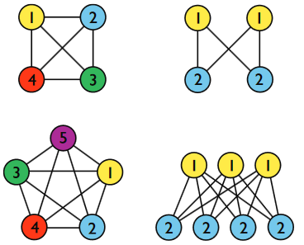
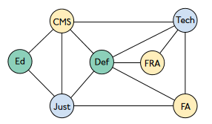
8.8 Graph Coloring
Example:
Julia Rahman, Dept. CSE, RUET
60

Slide 65
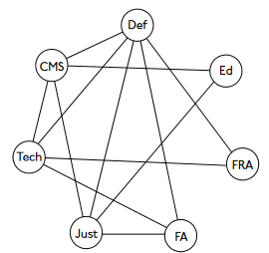
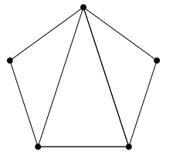
8.8 Graph Coloring
Example: How many colors are needed?
H
G
Julia Rahman, Dept. CSE, RUET
60

